Slide 1
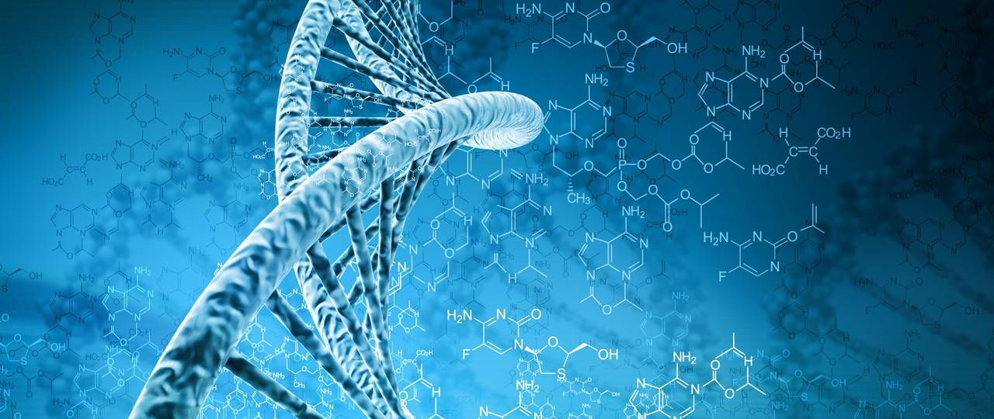
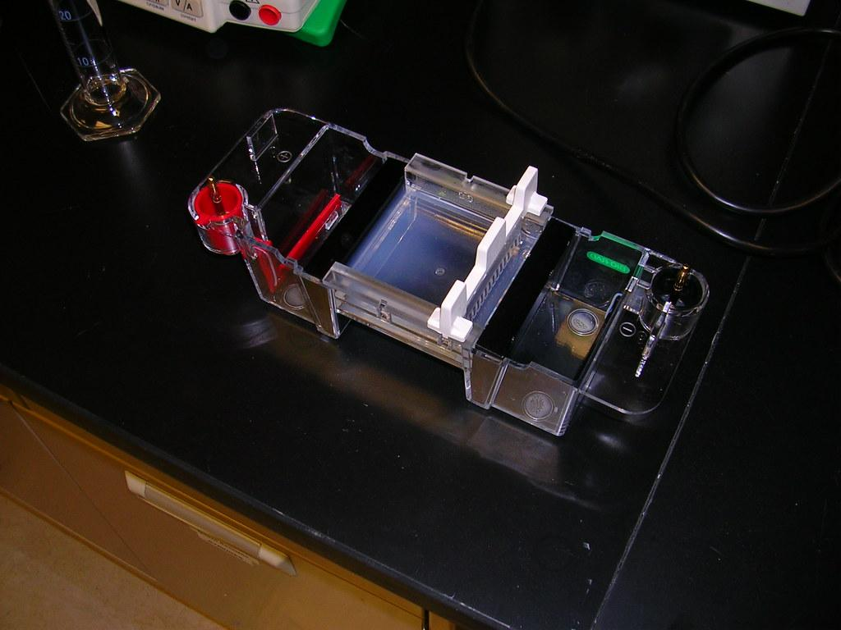
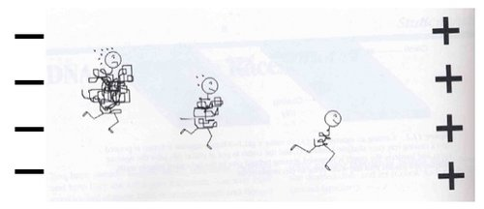
Lab 6: Gel electrophoresis, sanger sequencing

Slide 2
Lab roadmap
YOU ARE HERE:
Gel electrophoresis and sanger sequencing DUE TODAY
Lab 6 prelab
WEEK 7
Skills Demonstrations & Project Check-Ins
WEEK 8
Lab 7 prelab
Rough Draft of Science Communication Project (Data will be available on Canvas)

Slide 3
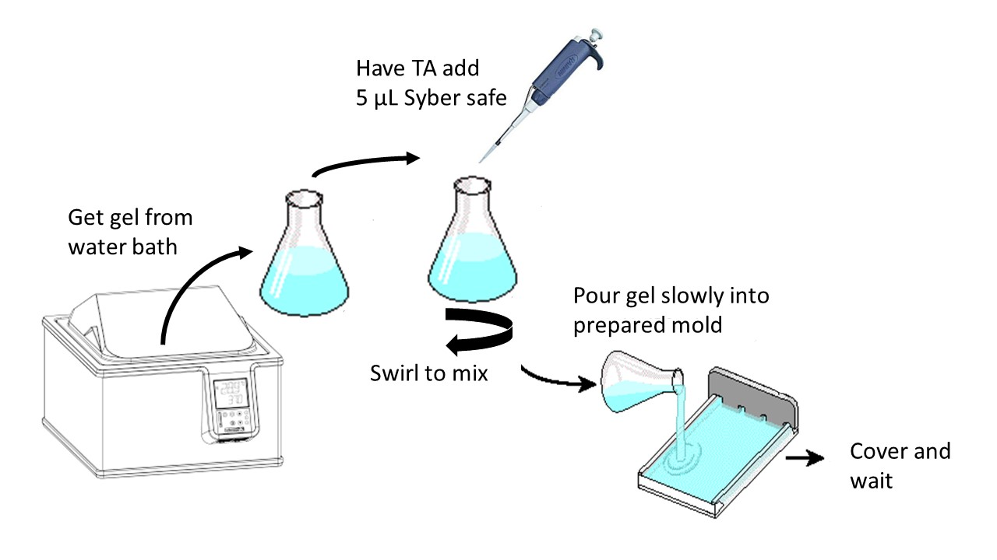
Outline
Pour Gel
Introduction
Finish Part I: get gels running while gels run:
Intro to Group Presentations
Part 2 DNA to disease
Part 3: prep for sequencing

Slide 4
But First …
Pour your gel
Complete steps 1-5 in your manual (pg 49)
Step 1: Add the rubber stoppers to the end of the tray
Step 2: Add the comb (small side down)
Step 3: Get a flask of Agarose gel from the water bath
Step 4: Have TA pipette sybersafe dye into gel and swirl to mix
Step 5: Slowly pour the gel into the casting tray (no bubbles) halfway up the gaps in the comb.
Step 6: Return to your seat for intro

Slide 5
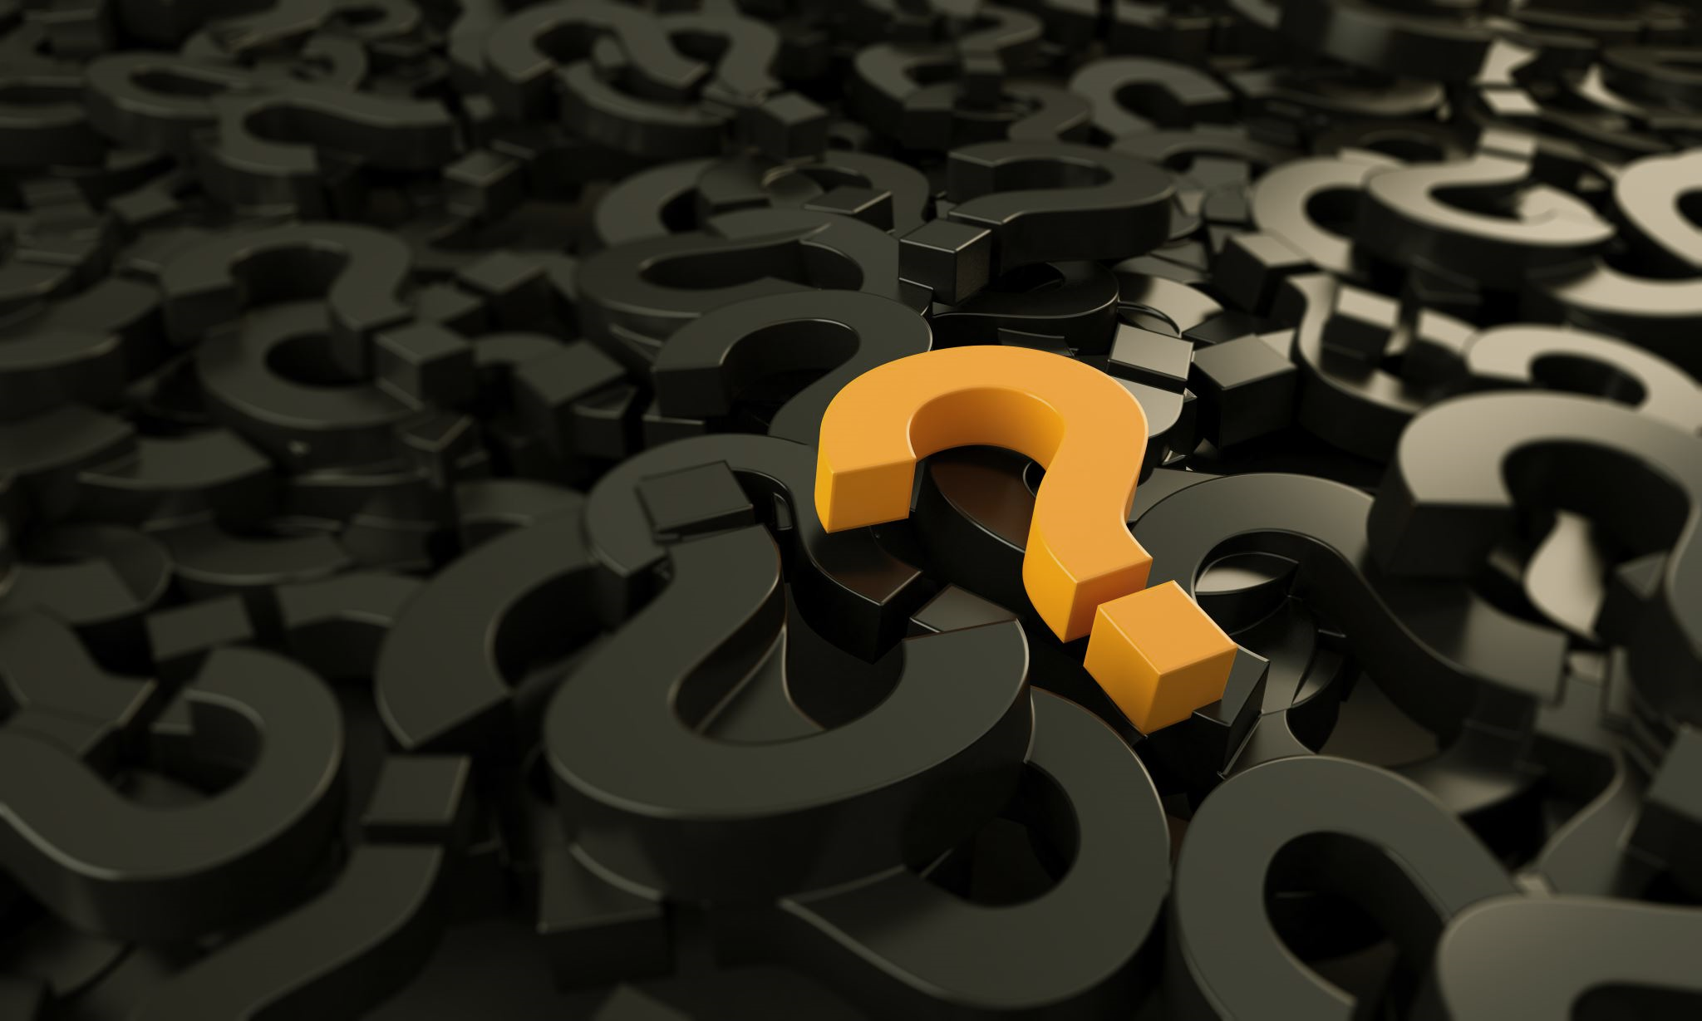
Questions?

Slide 6
Outline
Pour Gel
Introduction
Finish Part I: get gels running while gels run:
Intro to Group Presentations
Part 2: DNA to disease
Part 3: prep for sequencing

Slide 7
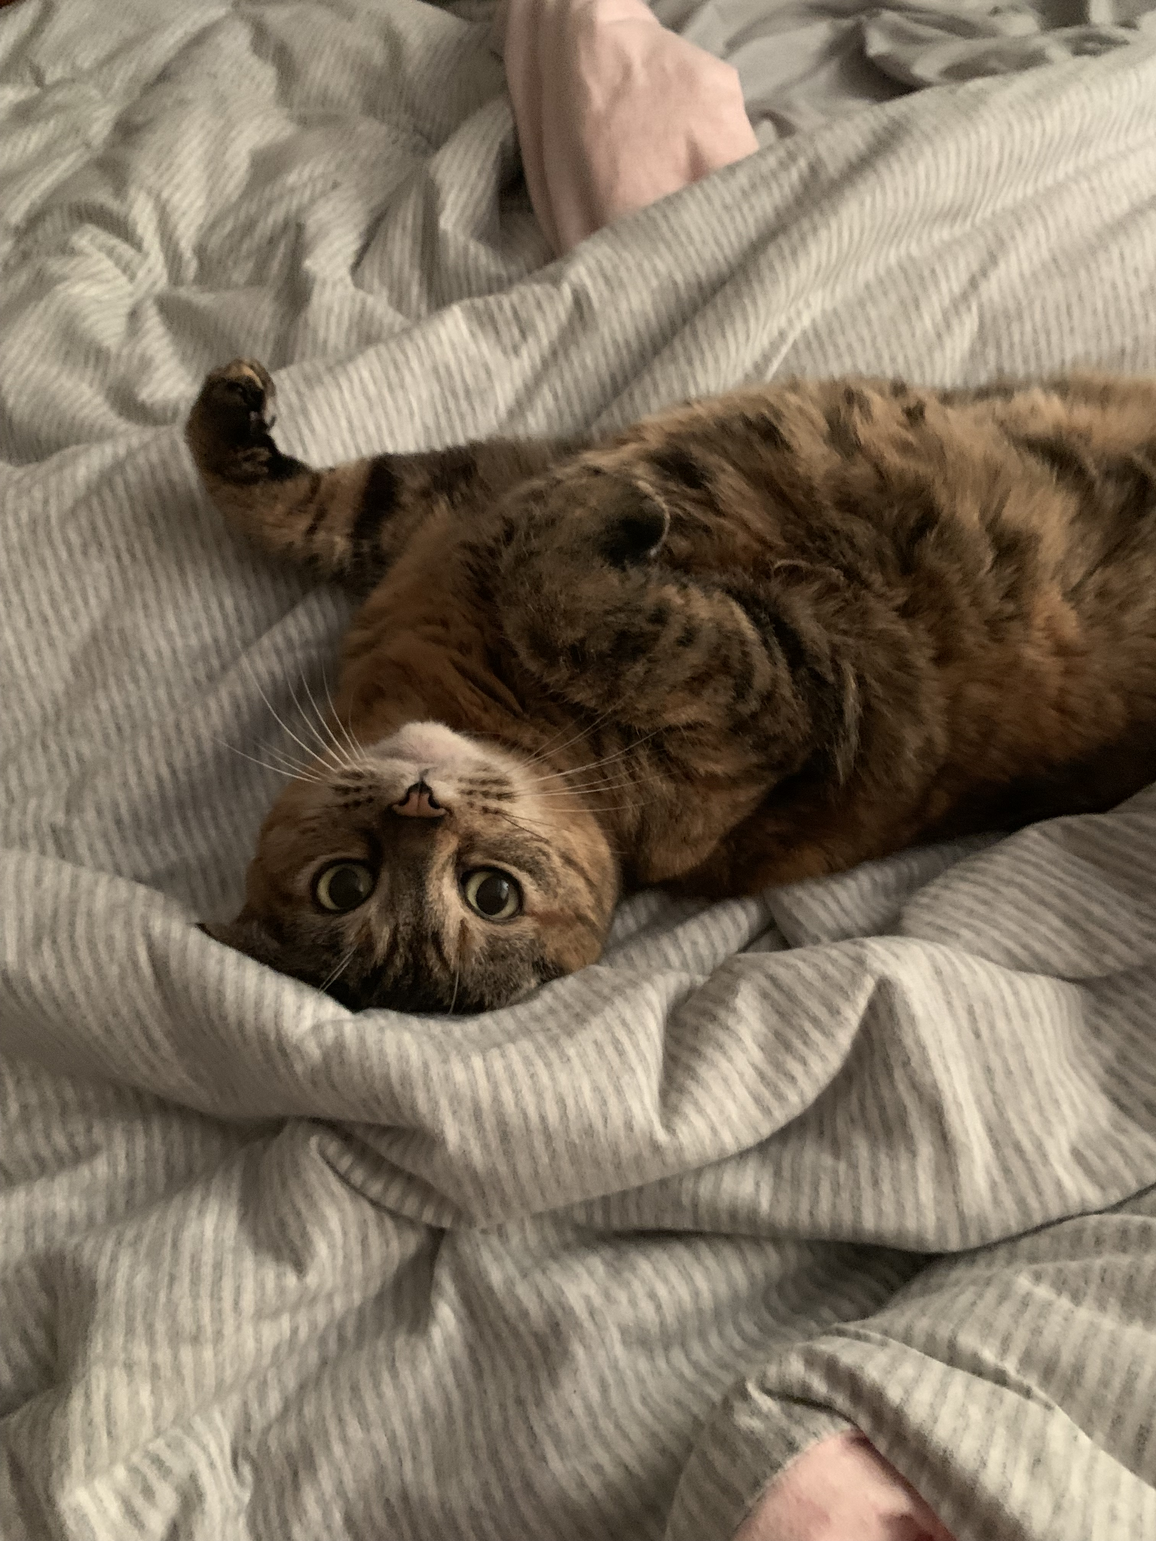
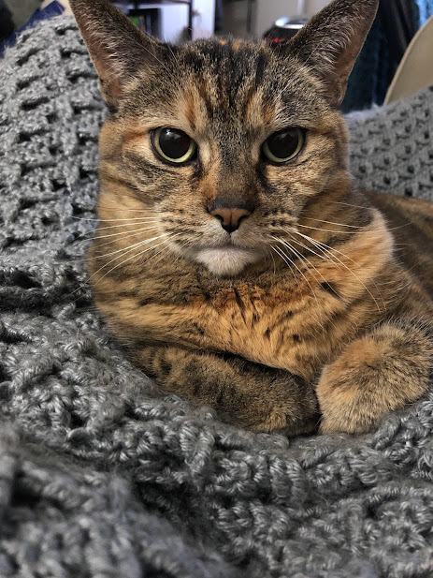
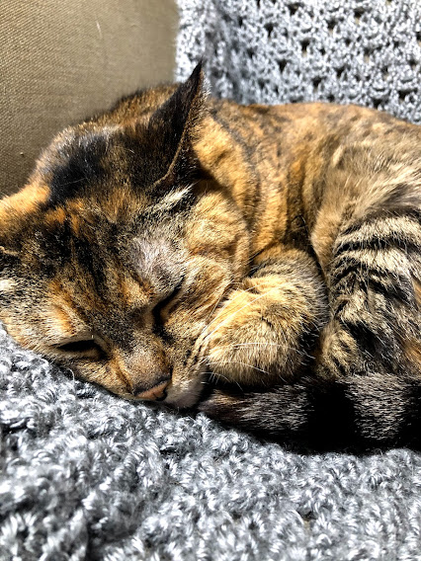
Lab 6: Lab background

Slide 8
Lab Objectives
Explain the basic principles of electrophoresis and how it is used to separate DNA fragments.
Demonstrate the ability to use molecular biology skills including gel electrophoresis and using micropipettes
Demonstrate the knowledge of sanger sequencing. Explain the central dogma of molecular biology.
Notes:
Lab objectives = what to study

Slide 9
Lab Objectives
Explain the basic principles of electrophoresis and how it is used to separate DNA fragments.
Demonstrate the ability to use molecular biology skills including gel electrophoresis and using micropipettes
Demonstrate the knowledge of sanger sequencing. Explain the central dogma of molecular biology.
TLDR: demonstrate gel electrophoresis skills and knowledge – including the central dogma of molecular biology.
Notes:
Lab objectives = what to study

Slide 10
Experimental Studies with Nematodes
Sample Collection
DNA Extraction
DNA Amplification
Gel Electrophoresis
Prepare for Sanger Sequencing
Notes:
Roadmap of what we’ve done and what we’re doing today

Slide 11
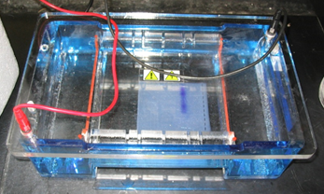
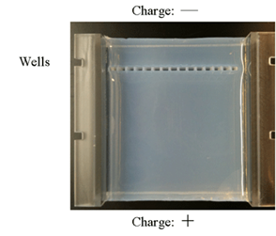
Gel Electrophoresis
Goal: Separate DNA by size
Tool: Gel Electrophoresis
Gel acts as a molecular sieve,
allowing the movement of different sizes of DNA fragments

Slide 12
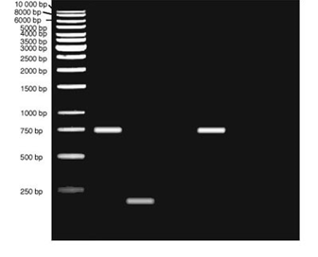
Gel Electrophoresis
DNA Ladder: Weight Standards
DNA fragments move through matrix of agarose
Negatively charged DNA will move towards positive electrode
As DNA migrates, different fragments will form bands

Slide 13
Gel Electrophoresis
Smaller fragments move faster and more easily because larger fragments are more obstructed by the gel.

Slide 14
Preparation for Sanger Sequencing
Notes:
Fluorescent tags added during PCR. Size separation in gel helps determine sequence (beginning nucleotide of each piece in part 1 get read in steps 2 and 3)
Sanger sequencing is a method used to determine the exact order of nucleotides in the DNA strand. First, you start with a piece of DNA that you want to read. This DNA serves as a template.
A mixture of normal nucleotides (A, T, C, G) and special dideoxynucleotides (ddNTPs) is added. The dideoxynucleotides are labeled with different fluorescent dyes and are crucial because they terminate the DNA strand when incorporated.
The DNA polymerase begins adding nucleotides to the growing DNA strand. When a dideoxynucleotide is added, it stops further extension of that particular strand.
As the process continues, many different DNA fragments of varying lengths are created. Each fragment ends with a dideoxynucleotide that corresponds to a specific base (A, T, C, or G).
The DNA fragments are separated using a technique called gel electrophoresis (or capillary electrophoresis). In this process, the fragments are pulled through a gel or a narrow tube by an electric current, with shorter fragments moving faster than longer ones.
The separated fragments are then detected, typically using a fluorescent scanner. The different colors of the fluorescent labels correspond to the specific dideoxynucleotides at the end of each fragment.
Finally, the order of the colors (and thus the dideoxynucleotides) is recorded, allowing scientists to reconstruct the original DNA sequence based on the lengths of the fragments and the identity of the terminating bases.

Slide 15
Lab 6: Today’s activities

Slide 16
Part 1: Gel electrophoresis
Once your gel has cooled…
Step 1: Remove rubber stoppers and comb (carefully!)
Step 2: Submerge the tray containing the gel into the gel rig with the wells on the side of the negative electrode
Step 3: Load the molecular weight marker, and the DNA
Step 4: Put the top on the gel rig – wells at the neg. end Step 5: Turn it on
Step 6: Make sure you see bubbles
Step 7: Cover the rig with the box
Step 8: Wait 25-30 minutes for the gel to run (check periodically)

Slide 17
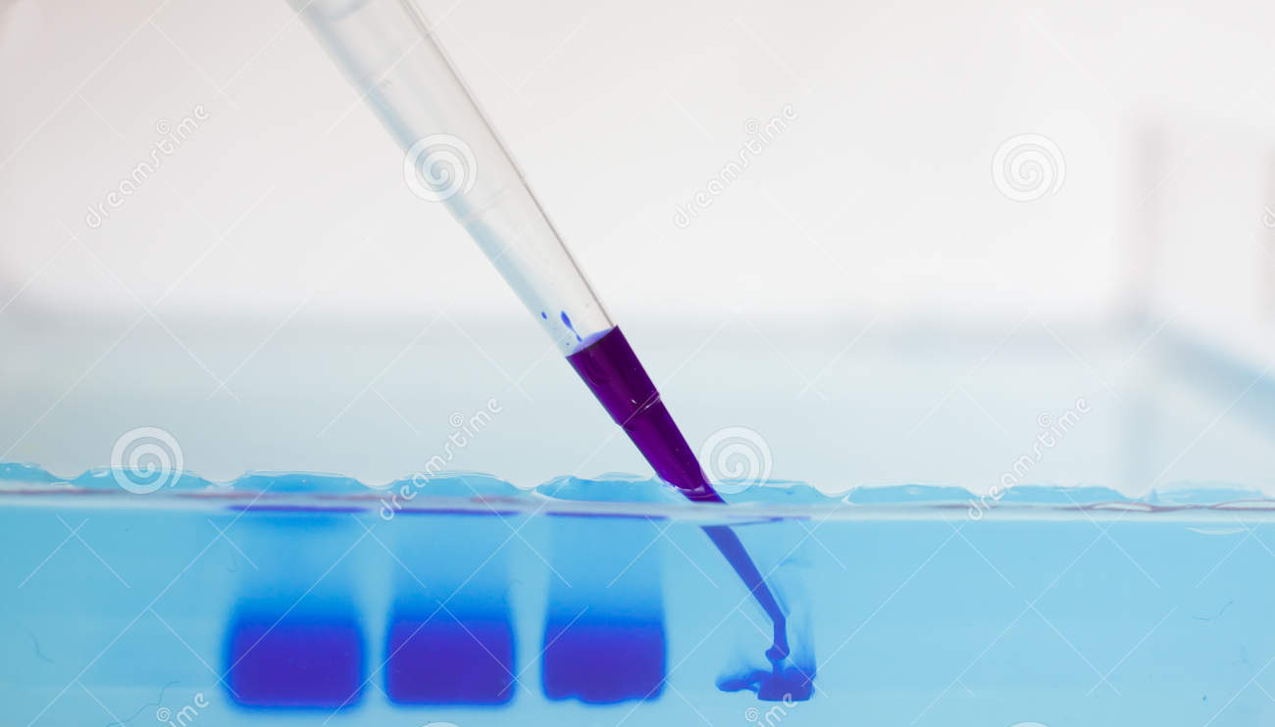
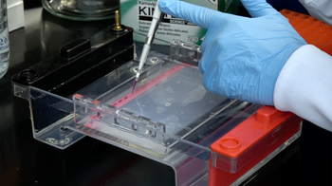
Practice Loading the Gel!
Practice using practice gels and green dye
Make sure that the dye goes into the well and you don’t puncture the well

Slide 18
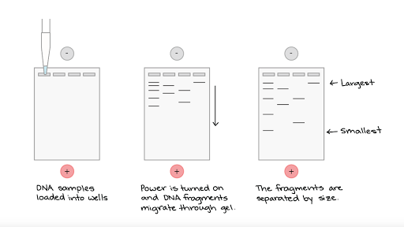
ladder
6 ul: 4 ul sample + 2ul dye

Slide 19
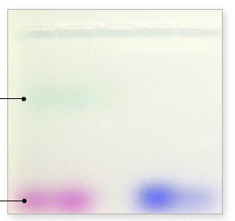
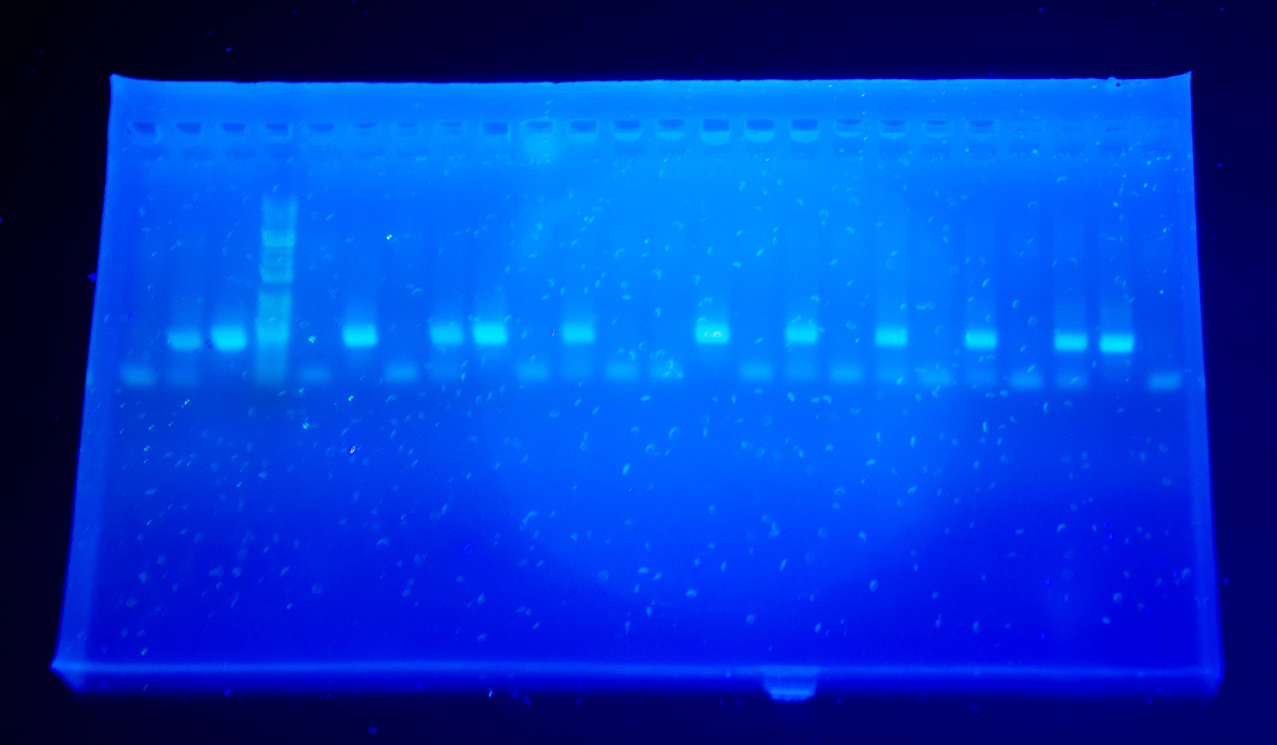
Visualizing DNA: Blue Light Camera
When the dye is halfway down the gel
Step 1: Turn off the rig
Step 2: Remove the gel
Step 3: Take the gel to the viewing station
Step 4: Take a picture with your cell phone camera
What you’ll see under blue light
What you’ll see under normal light

Slide 20
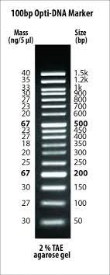
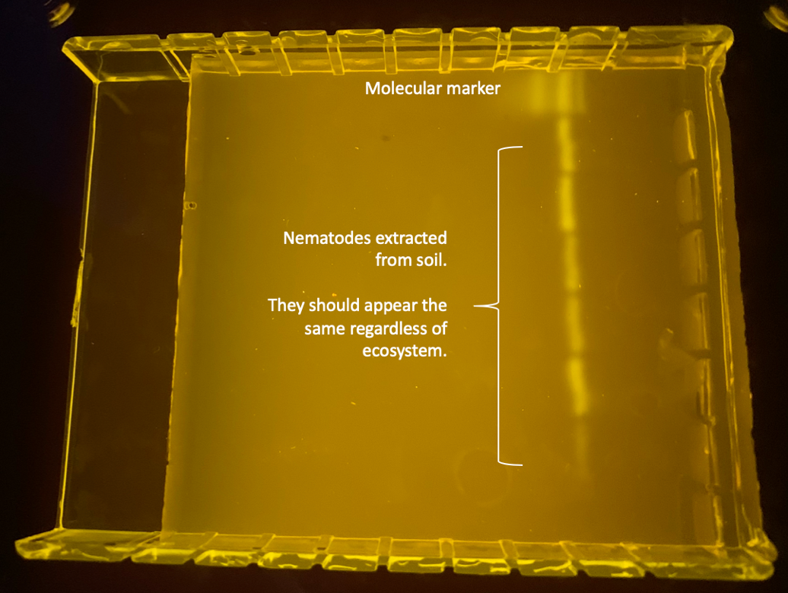
Interpreting your gel
800 bp
Notes:
The bands will look the same for all ecosystems and species extracted from the soil (the identity of the nematodes will be determined through Sanger sequencing). Band present indicates successful extraction.
Band size should be approximately 800 bp

Slide 21
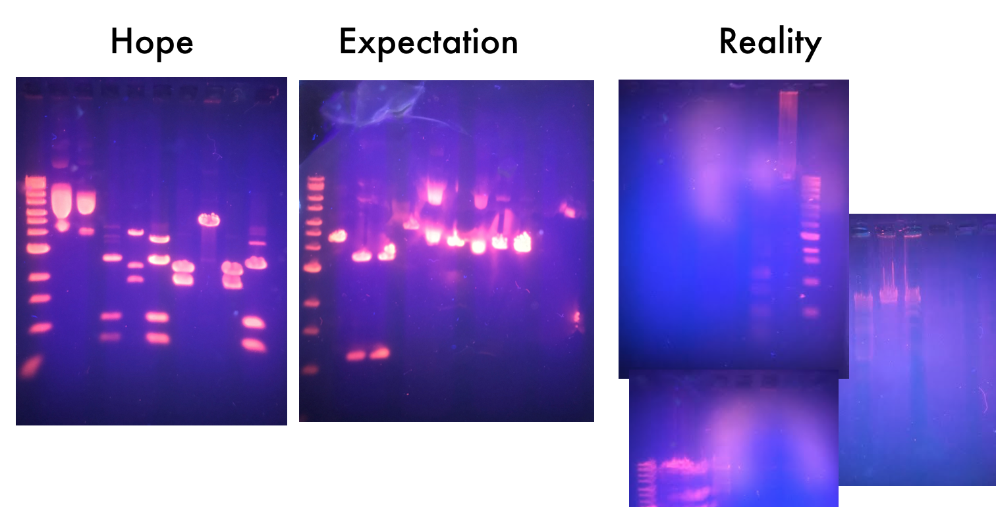
Notes:
Reminder that their results might not look like perfect lines. It’s hard.

Slide 22
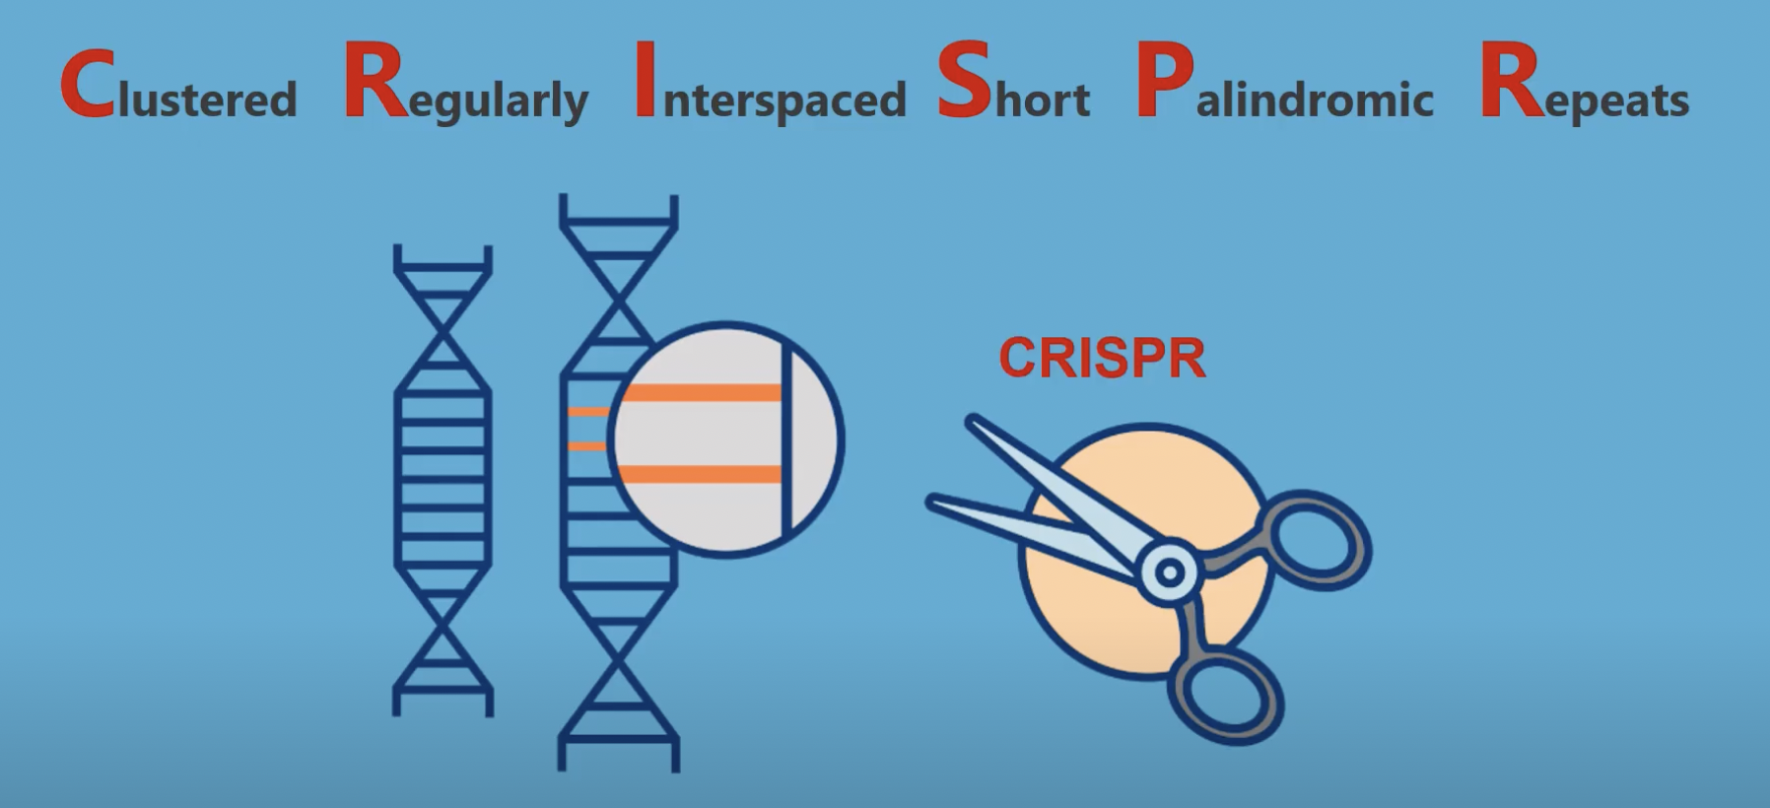

Slide 23
While gel runs: Biological Frontiers Group Presentation
The purpose of this assignment is to critically analyze and communicate the societal implications of topics from BI221.
Learning Outcomes:
Directly linked to the Core Education Learning Outcome: Articulate the consequences and implications of science for society, daily life, and decision-making.
Effectively convey complex scientific concepts related to a specific topic in a manner accessible to a general audience.
Summarize the societal impacts of the topic using scientific evidence.
Evaluate ethical dilemmas and societal implications associated with the topic, demonstrating an awareness of potential ethical challenges in the field.
Justify your stance on the societal impacts of the chosen topic using evidence and ethical considerations.

Slide 24
While gel runs: Biological Frontiers Group Presentation
Work collaboratively with your peers to delve into a chosen topic within related to content in Bi221 and social implications.
Select one of the topics from the list on Canvas or propose your own topic for approval
Create a short group presentation that:
Demonstrates a thorough understanding of the chosen topic, incorporating relevant scientific principles, methodologies, and recent advancements.
Communicates scientific concepts clearly and effectivity using appropriate terminology and examples appropriate for the audience
Clearly articulates a well-supported stance on the societal impacts of the chosen topic
Presentation should be polished, well-organized and engaging and must demonstrate strong collaboration and teamwork with all members contributing to the presentation equally

Slide 25
While gel runs: DNA to Disease
• Obtain the DNA sequence on your table
• Determine the phenotype caused by the mutation in the sequence by converting to the complementary mRNA sequence, codons, and amino acid sequence.
• Amino acid charts and protein names on Canvas
• Use NCBI (National Center for Biotechnology Information) BLAST to align sequences

Slide 26
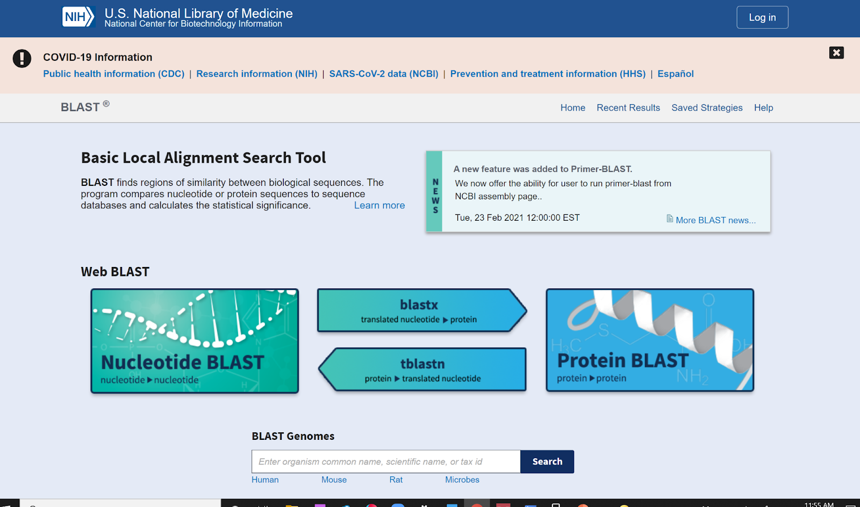
What is BLAST?
Basic Local Alignment Search Tool (BLAST)
Finds regions of local similarity between sequences (nucleotide or protein).
Compares sequences to sequence databases
Calculates the statistical significance of matches.
Uses:
Can be used to infer functional and evolutionary relationships
Help identify members of gene families
Notes:
National Center for Biotechnology Information; This is a huge datebase of Genotypes of different organisms/ protein sequence of different organisms and what they code for.

Slide 27
Part 3: Prep for sanger sequencing
Only do this step if you have results from your gel
Do not mix PCR products
Use a new tip each time
Unique ID is your 2-digit lab section (11), 2-digit table number (0X), and letter for sample replicate (Example 1101A)
There are thousands of samples being submitted for sequencing. If you do not have the correct unique ID, your samples may get lost

Slide 28
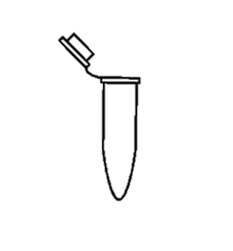

Part 3: Prep for sanger sequencing
Only do this step if you have results from your gel
Do not mix PCR products
Use a new tip each time
Unique ID is your lab section (11H), 2-digit table number (0X), and letter for sample replicate (Example 1101A)
There are thousands of samples being submitted for sequencing. If you do not have the correct unique ID, your samples may get lost
PCR products from last week
Diluted Samples 2 ul PCR product + 18 ul water
19.6 ul water + 2.4 ul primer + 2 ul diluted sample
Notes:
Describe that there are things in the soil that can inhibit pcr
Because of this, we have to dilute our samples to reduce inhibitors
They will do this by adding 2 ul of dna from their samples (6 total soil samples – no exceptions) and 18 ul of water to a new set of 6 tubes

Slide 29
Part I: gel electrophoresis
DO NOT remove gel from casting tray. Just remove the colored ends and the comb. Be careful removing the comb to avoid damaging the wells.
Keep casting tray pieces with your tray. They are not all interchangeable, so try to not leave them behind!
Don’t use outer most wells
Make sure the wells are at the negative end before turning on
Check for bubbles before covering
Don’t throw away your samples yet, you will hopefully need it for part 4!
Part 2: DNA to disease
Links to websites on Canvas: modules > lab materials > lab activity links
Part 3: prep for sanger sequencing
Only do this part if you got DNA in part I. Primers are in the freezer.
Make sure you label your samples correctly: Lab sec + table # + unique letter identifier 4008A, 4008B,..
Clean
Your group’s gel rig area needs to be clean in addition to your station
Used gel, tubes, used pipette tips → garbage
Log off computers, organize stations.
Today’s Roadmap and Tips

